Slide 1
2025 Popcorn Sale
What to do now for a successful fall!

Slide 2
Agenda
Welcome Calendar Review
5 things to do now for a successful fall Q&A
Adjourn

Slide 3
Key Dates
July 22. GO WILD POPCORN KICKOFF
July 22-24. Show & Sell Reservations go live
July 24. West & East Kickoff/Orientation
Aug 1. Online Sales Commission Starts
Aug 14. Show & Sell Order deadline
Aug 27. Show & Sell Popcorn Distribution
Aug 29. SALE STARTS!
Sept. 4. Show & Sell Popcorn Distribution
Sept 5. Popcorn Show & Sell Starts
Sept 5-26 Blitz Club
Sept 27. Swap & Shop- 9am

Slide 4
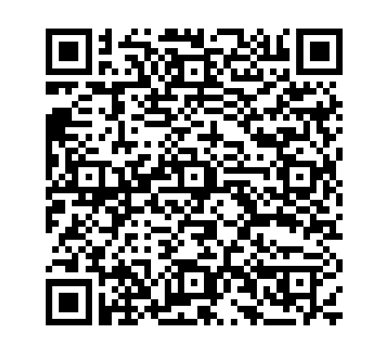
5 Things to do now for a GREAT Sale!
Register for the sale on Trails End.
The QR Code is on the screen now.
This ensures you will get ALL communications, promotions, can place an order, and you have access to sign up for Show and Sell Dates.
You must register at least 1 unit kernel/chair….but Multiple is better! Register them as co-kernels!

Slide 5
Recruit a Chair/Kernel
How many of you on the call are a Cubmaster, Scoutmaster, Crew Advisor, etc?
It is vital to recruit a parent/leader to run the sale so you can focus on running the unit program.
It is an important role and should be a team.
Show and Sell Lead, Pick-up/distribution lead, unit kick-off chair, etc.
Make it fun!

Slide 6
Plan your calendar
Include attending our Kick-off on July 22
Target Show and Sell Dates
Booked through unit leader portal
Opens in Mid July.
Host Neighborhood Blitz days, check school and community calendars for festivals and events.
Schedule Online Sales Blitz Weeks---
watch for Trails End Promotions.
Different from past years! We’re going wild and having booths, contests, fun, games, and prizes on the 22nd!
Schedule, promote, and host a Unit Kick-off!
2 Audiences. Scouts and Adults.
Make it fun, have a goal for your unit,
tell families WHY!
Suggested timeframe: July 25-August 5. Before Show and Sell begins

Slide 7
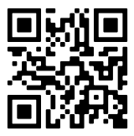
Scout Families-GET THE APP
Encourage families to sign up early.
Trails End and our Council communicate with all registered families via email.
Units use your communication platform to invite families to sign up and then track it.
By signing up early prepared to sign up for Show and Sell shifts, enter a goal, sell online, and take orders from friends and family.

Slide 8
Scouts and Families Love Prizes and Incentives!
Review the GSMC Prize Program
Final Coming soon
Commissions have raised across the board!
Going with Trails-End Incentives only this year
Additional Gift Cards available- can choose multiple cards
Plan additional incentives at Unit and/or Scout level.
Focus on high sales/top sellers
Incentivize parents---Sell $X and get X. Dues
paid, big trip/event free, etc.

Slide 9
Questions?
Tracy Slice
Tracy.Slice@scouting.org
865-566-0642
Nathan Cunningham
Nathan.Cunningham@scouting.org
865-686-2353
Trails End
support@trails-end.com
Trails End Facebook group

Slide 10
Thank you

